Slide 1

Improving
Seq2Seq Model

Slide 2
LSTM
LSTM
LSTM
LSTM
LSTM
[h,c]
I
can
swim
very
well
So far...

Slide 3

Stacked LSTM

Slide 4
LSTM
LSTM
LSTM
LSTM
LSTM
[h,c]
h₀
h₁
h₃
h₄
h₅
LSTM
LSTM
LSTM
LSTM
LSTM
I
can
swim
very
well
Two LSTMs stacked over each other .. to learn deeper features

Slide 5
LSTM
LSTM
LSTM
LSTM
LSTM
[h,c]
h₀
h₁
h₃
h₄
h₅
LSTM
LSTM
LSTM
LSTM
LSTM
h₀
h₁
h₃
h₄
h₅
LSTM
LSTM
LSTM
LSTM
LSTM
I
can
swim
very
well
We can stack more and more

Slide 6
….
model.add(LSTM(256, return_sequences=True))
model.add(LSTM(256, return_sequences=True))
model.add(LSTM(256, return_sequences=True))
model.add(LSTM(256))
….
Implementing in Keras - 4 stacked LSTMs

Slide 7

Bidirectional LSTM

Slide 8
Target Words (Shifted by one time step)
Encoder
Decoder
Padded Input Sequences
Sentence Embedding
Padded Target Sequences
Memory of words at the beginning may not be as strong as words near the end

Slide 9
Bidirectional LSTMs
I
can
swim
very
well
I
can
swim
very
well
We can use two LSTMs.
Data for one LSTM gets fed in forward direction
while for other LSTM, data is fed in reverse direction
... for better learning

Slide 10
What is the output Bidirectional LSTM?

Slide 11
I
can
swim
very
well
I
can
swim
very
well
Output of both LSTM gets merged . . .

Slide 12
Implementing in Keras - Bidirectional LSTM
model.add(Bidirectional(LSTM(256, return_sequences=True, merge_mode=’concat’))
merge_mode can be ‘concat’, ‘sum’ or ‘mul’

Slide 13
We can try Deep Bidirectional LSTM as well

Slide 14

But long sentences can still be problematic :(

Slide 15
Target Words (Shifted by one time step)
Info about the whole sequence gets stored in the memory of last step …
Encoder
Decoder
Padded Input Sequences
Sentence Embedding
Padded Target Sequences
. . .last LSTM state may not have adequate information from all the inputs especially earlier time steps

Slide 16

What if we provide information from hidden states at all time steps ...

Slide 17
Decoder
Hidden state from time step 0 → h₀
h₁
h_{n-1}
LSTM
LSTM
LSTM
LSTM
[h,c]
Hidden state (information) from each time step in Encoder is shared with Decoder ...
x₁
x₂
x_{n-1}
x_{n}
Encoder

Slide 18
Decoder
h₀
h₁
h_{n-1}
LSTM
LSTM
LSTM
LSTM
[h,c]
How much data Decoder is getting to look at?
(Number of time steps + 2)
X
RNN state size
x₁
x₂
x_{n-1}
x_{n}
Encoder

Slide 19
. . . may be decoder is getting too much information :(
Decoder
h₀
h₁
h_{n-1}
LSTM
LSTM
LSTM
LSTM
[h,c]
How much data Decoder is getting to look at?
(Number of time steps + 2)
X
RNN state size
x₁
x₂
x_{n-1}
x_{n}
Encoder

Slide 20

How can we give only the right information (and not everything)?
Attention

Slide 21
Now what is Attention?
Let’s take an example ...

Slide 22
A Question
The Answer
Where
I
did
studied
you
at
study
Panipat
How did we get different words in the answer?

Slide 23
A Question
An Answer
Where
I
How did we come with 1st word ‘I’?
did
studied
you
at
study
Panipat
We paid attention to word ‘you’ in the question ... we can easily ignore other word(s) in the input

Slide 24
A Question
An Answer
Where
I
did
studied
How did get 2nd word ‘studied’?
you
at
study
Panipat
We paid attention to two words ‘study’ and ‘did’ in the question ...

Slide 25
A Question
An Answer
Where
I
did
studied
you
at
How did get 3rd word ‘at’?
study
Panipat
We paid attention to the word ‘where’ in the question ...

Slide 26
A Question
An Answer
Where
I
did
studied
you
at
study
Panipat
How did get 4th word ‘Panipat’?
We paid attention to the word ‘where’ in the question ...

Slide 27
Question
 | Where | did | you | study
I | No | No | Yes | No
studied | No | Yes | No | Yes
at | Yes | No | No | No
Panipat | Yes | No | No | No
Attention Matrix
Answer

Slide 28
Question
 | Where | did | you | study
I | 0.0 | 0.0 | 1.0 | 0.0
studied | 0.0 | 0.3 | 0.0 | 0.7
at | 1.0 | 0.0 | 0.0 | 0.0
Panipat | 1.0 | 0.0 | 0.0 | 0.0
Attention Matrix
(In numbers)
Answer

Slide 29
Question
 | Where | did | you | study
I | 0.0 | 0.0 | 1.0 | 0.0
studied | 0.0 | 0.3 | 0.0 | 0.7
at | 1.0 | 0.0 | 0.0 | 0.0
Panipat | 1.0 | 0.0 | 0.0 | 0.0
Attention Matrix
(In numbers)
Answer
‘Studied’ paid more attention on ‘study’ and smaller attention on ‘did’.

Slide 30
How would Attention look in Seq2Seq model?

Slide 31
What hidden states from question will be sent for 1st word ‘I’ in the answer?
Decoder
h₀
h₁
h₂
h₃
LSTM
LSTM
LSTM
LSTM
[h,c]
Where
did
you
study
Encoder

Slide 32
What hidden states from question will be sent for 1st word ‘I’ in the answer?
Decoder
Attention weights for ‘I’
[0, 0, 1, 0 ]
As ‘I’ is coming from only ‘you’
h₀
h₁
h₂
h₃
LSTM
LSTM
LSTM
LSTM
[h,c]
Where
did
you
study
Encoder

Slide 33
What hidden states from question will be sent for 1st word ‘I’ in the answer?
Attention weights for ‘I’ → [0, 0, 1, 0 ]
Decoder
Multiply values by 0 → 0 x h₀
0 x h₁
1 x h₂
0 x h₃
h₀
h₁
h₂
h₃
LSTM
LSTM
LSTM
LSTM
[h,c]
We provide weighted hidden states
(multiplied by attention weights)
Where
did
you
study
Encoder

Slide 34
What hidden states from question will be sent for 1st word ‘I’ in the answer?
Attention weights for ‘I’ → [0, 0, 1, 0 ]
Decoder
Multiply values by 0 → 0 x h₀
0 x h₁
1 x h₂
0 x h₃
h₀
h₁
h₂
h₃
How much data Decoder is getting to look at?
LSTM
LSTM
LSTM
LSTM
[h,c]
Where
did
you
study
Encoder

Slide 35
What hidden states from question will be sent for 1st word ‘I’ in the answer?
Attention weights for ‘I’ → [0, 0, 1, 0 ]
Decoder
Multiply values by 0 → 0 x h₀
0 x h₁
1 x h₂
0 x h₃
h₀
h₁
h₂
h₃
LSTM
LSTM
LSTM
LSTM
[h,c]
How much data Decoder is getting to look at?
(Number of time steps +2) X RNN state size
Where
did
you
study
Encoder
. . . still the same amount of numbers as earlier :(

Slide 36
How do we provide ‘only’ the right info with less data to Decoder?

Slide 37
What hidden states from question will be sent for 1st word ‘I’ in the answer?
Attention weights for ‘I’ → [0, 0, 1, 0 ]
Decoder
Context Vector
Add
0 x h₀
0 x h₁
1 x h₂
0 x h₃
LSTM
LSTM
LSTM
LSTM
[h,c]
We first summarize all hidden states before sending it Decoder
Where
did
you
study
Encoder

Slide 38
What hidden states from question will be sent for 1st word ‘I’ in the answer?
Attention weights for ‘I’ → [0, 0, 1, 0 ]
Decoder
Context Vector
Add
0 x h₀
0 x h₁
1 x h₂
0 x h₃
LSTM
LSTM
LSTM
LSTM
[h,c]
How much data Decoder is getting to look at?
3 * RNN state size
Where
did
you
study
Encoder

Slide 39

Yay!
We are providing ‘only’ relevant information with less amount of numbers!!!

Slide 40
Context vector for 2nd word ‘studied’
Attention weights for studied’ → [0, 0.3, 0, 0.7 ]
Decoder
Context Vector
Add
0 x h₀
0.3 x h₁
0 x h₂
0.7 x h₃
LSTM
LSTM
LSTM
LSTM
[h,c]
Where
did
you
study
Encoder

Slide 41
Context vector for 3rd word ‘at’
Attention weights for studied’ → [1, 0, 0, 0 ]
Decoder
Context Vector
Add
1 x h₀
0 x h₁
0 x h₂
0 x h₃
LSTM
LSTM
LSTM
LSTM
[h,c]
Where
did
you
study
Encoder

Slide 42
Context vector for 4th word ‘Panipat’
Attention weights for studied’ → [1, 0, 0, 0 ]
Decoder
Context Vector
Add
1 x h₀
0 x h₁
0 x h₂
0 x h₃
LSTM
LSTM
LSTM
LSTM
[h,c]
Each decoder output gets relevant ‘Context Vector’
Where
did
you
study
Encoder

Slide 43
How do we get Attention weights for each Decoder output?

Slide 44
Encoder LSTM generates hidden states at each step and also provides sentence embedding
h_{e1}
h_{e2}
h_{e3}
h_{en}
LSTM
LSTM
LSTM
LSTM
[h,c]
Where
did
you
study
Encoder

Slide 45
Decoder takes sentence embedding and generates hidden state at each step
h_{e1}
h_{e2}
h_{e3}
h_{en}
h_{d1}
h_{d2}
h_{d3}
h_{dm}
LSTM
LSTM
LSTM
LSTM
LSTM
LSTM
LSTM
LSTM
Where
did
you
study
<start>
I
studied
Panipat
Encoder
Decoder

Slide 46

Calculating attention weights for
1st decoder output

Slide 47
Align all encoder states h_{e} with 1st decoder hidden state h_{d1}
h_{d1}
h_{d2}
h_{d3}
h_{dm}
h_{e1}
h_{e2}
h_{e3}
h_{em}
LSTM
LSTM
LSTM
LSTM
LSTM
LSTM
LSTM
LSTM
Where
did
you
study
<start>
I
studied
Panipat
Encoder
Decoder

Slide 48
How do we align hidden states?

Slide 49
We do a ‘dot’ product between each encoder states h_{e} with 1st decoder hidden state h_{d1}
h_{d1}
h_{d2}
h_{d3}
h_{dm}
h_{e1}
h_{e2}
h_{e3}
h_{em}
LSTM
LSTM
LSTM
LSTM
LSTM
LSTM
LSTM
LSTM
Where
did
you
study
<start>
I
studied
Panipat
Encoder
Decoder

Slide 50
For each input word, we will get one number
2
7
121
17
h_{d1}
h_{d2}
h_{d3}
h_{dm}
h_{e1}
h_{e2}
h_{e3}
h_{em}
LSTM
LSTM
LSTM
LSTM
LSTM
LSTM
LSTM
LSTM
Where
did
you
study
<start>
I
studied
Panipat
Encoder
Decoder

Slide 51
Attention weights to generate I
We pass all numbers through Softmax function
0
0
.99
.01
Softmax
2
7
121
17
h_{d1}
h_{d2}
h_{d3}
h_{dm}
h_{e1}
h_{e2}
h_{e3}
h_{em}
LSTM
LSTM
LSTM
LSTM
LSTM
LSTM
LSTM
LSTM
Where
did
you
study
<start>
I
studied
Panipat
Encoder
Decoder

Slide 52
Attention weights to generate I
What’s next?
0
0
.99
.01
We build Context Vector
Softmax
2
7
121
17
h_{d1}
h_{d2}
h_{d3}
h_{dm}
h_{e1}
h_{e2}
h_{e3}
h_{em}
LSTM
LSTM
LSTM
LSTM
LSTM
LSTM
LSTM
LSTM
Where
did
you
study
<start>
I
studied
Panipat
Encoder
Decoder

Slide 53
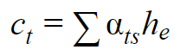
Summarizes importance of each input
Multiply attention weights with encoder hidden states
Element-wise addition of multiplication output
Context Vector
0.0
0.0
0.99
0.01
h_{d1}
h_{d2}
h_{d3}
h_{dm}
LSTM
LSTM
LSTM
LSTM
LSTM
LSTM
LSTM
LSTM
Where
did
you
study
<start>
I
studied
Panipat
Encoder
Decoder

Slide 54
How do we predict 1st word e.g ‘I’ ?
We will use:
1st hidden state of decoder
Context vector for 1st word

Slide 55
I
FC layer with Softmax
Combine information from Context vector and decoder hidden state
Context Vector
attention vector
Dense
Concat
0.0
0.0
0.99
0.01
h_{d1}
h_{d2}
h_{d3}
h_{dm}
LSTM
LSTM
LSTM
LSTM
LSTM
LSTM
LSTM
LSTM
Where
did
you
study
<start>
I
studied
Panipat
Encoder
Decoder

Slide 56
What’s next?
We build attention weights for 2nd decoder output

Slide 57
We do a ‘dot’ product between each encoder states h_{e} with 2nd decoder hidden state h_{d2}
5
115
9
127
h_{d1}
h_{d2}
h_{d3}
h_{dm}
h_{e1}
h_{e2}
h_{e3}
h_{em}
LSTM
LSTM
LSTM
LSTM
LSTM
LSTM
LSTM
LSTM
Where
did
you
study
<start>
I
studied
Panipat
Encoder
Decoder

Slide 58
Attention weights to generate studied
0
0.3
0
.7
We pass all numbers through Softmax function
Softmax
5
115
9
127
h_{d1}
h_{d2}
h_{d3}
h_{dm}
h_{e1}
h_{e2}
h_{e3}
h_{em}
LSTM
LSTM
LSTM
LSTM
LSTM
LSTM
LSTM
LSTM
Where
did
you
study
<start>
I
studied
Panipat
Encoder
Decoder

Slide 59
studied
FC layer with Softmax
Context Vector
attention vector
Dense
Concat
0.0
0.3
0
0.7
h_{d1}
h_{d2}
h_{d3}
h_{dm}
LSTM
LSTM
LSTM
LSTM
LSTM
LSTM
LSTM
LSTM
Where
did
you
study
<start>
I
studied
Panipat
Encoder
Decoder

Slide 60

Repeat these steps to predict all output words using attention!

Slide 61
Global Attention
Effective Approaches to Attention-based Neural Machine Translation
Minh-Thang Luong, et al.

Slide 62
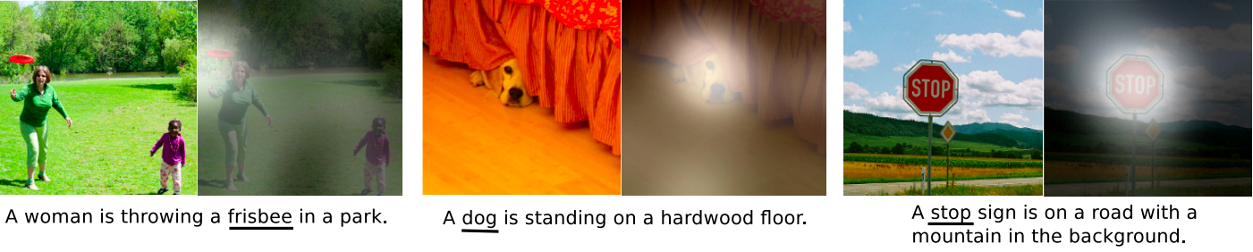
Seq2Seq model with Attention for image captioning
Show, attend and tell: Neural image caption generation with visual attention K. Xu, J. Ba, R. Kiros, K. Cho, A. Courville, R. Salakhutdinov, R.S. Zemel, Y. Bengio. arXiv preprint arXiv:1502.03044, Vol 2(3), pp. 5. CoRR. 2015.

Slide 63
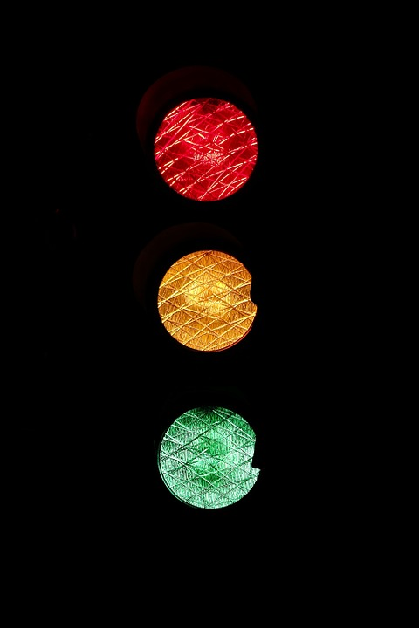
Implementing Attention!

Slide 64
Data Preprocessing
No Change

